Slide 1
NAME : NOONETY MANI MOKSHITH ROLL N0 : 1901124 MACHINE LEARNING MINI - PROJECT Clustering the feedbacks from Turkiye Student Evaluation dataset Dept. of Computer Science & Engineering Indian Institute of Information Technology, Guwahati. Course: CS360 - Machine Learning Lab

Slide 2
Turkiye Student Evaluation dataset(Unsupervised Learning)
which has unlabeled data ,the clustering algorithms discover data grouping without the need of human intervention.
3) Problem Definition:
Grouping the whole data into sufficient number of clusters.
Clustering Algorithms:K-Means Clustering Algorithm,K_Medoid,Fuzzy(FCM),SOM(Self organising feature Map)

Slide 3
About Dataset
This data set contains a total 5820 evaluation scores provided by students from Gazi University in Ankara (Turkey).
There is a total of 28 course specific questions and additional 5 attributes.
Q1-Q28 are all Likert-type, meaning that the values are taken from {1,2,3,4,5}
There are 3 instructors who are teaching 13 different courses
5820 patterns and 28 features are present in the dataset
Additional 5 Attributes:
instr: Instructor's identifier; values taken from {1,2,3}
class: Course code (descriptor); values taken from {1-13}
repeat: Number of times the student is taking this course; values taken from {0,1,2,3,...}
attendance: Code of the level of attendance; values from {0, 1, 2, 3, 4}
difficulty: Level of difficulty of the course as perceived by the student; values taken from {1,2,3,4,5}

Slide 4
Literature survey 1(Link)
Efficient Fusion based Neural Network (EF-NN)
The proposed Efficient Fusion Based Neural Network (EF-NN) classifier initially, where the dataset is processed and transferred to attributes selection, then transform the data for processing the signals further into classification. The hybrid model produces the concept of sentimental data classification with high accuracy. The target of this exploration is to upgrade the exhibition of crossover classifiers when taking care of or overseeing imbalanced information.
So, a pre-handling step is proposed before the characterization procedure. This proposed model encapsulates two procedures, first, it changes the dataset into a reasonable dataset utilizing the mix of the characteristic choice method. At that point, it chooses significant raits liable for a precise forecast by the methods for property choice procedure

Slide 5
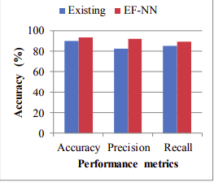
As recently referenced, the neurons inside the system cooperate with the neurons in the following layer, with each yield going about as a contribution for future capacity. Each capacity, including the underlying neuron, gets a piece of numeric information, and produces a numeric yield, because of a disguised capacity, which incorporates the expansion of an inclination term, which is novel for each neuron. That yield is then changed over to the numeric contribution for the capacity in the following layer, by being increased with a proper weight. This proceeds until one last yield for the system is delivered.
Performance
Existing is K-Means CLustering
The performance
of the proposed model is compared with the
existing k means clustering technique it
increases the 93% accuracy, 89% precision,
and 91 % recall.
Mr. D. Selvapandian1 , Mr. Thamba Meshach W2 , Mr.K.S.Suresh Babu3 , Dr.R.Dhanapal4 ,Dr.Jebakumar Immanuel.D5 On 2020-12-25

Slide 6
Literature survey 2:Developing an Optimized Feature Selection Process for Designing Efficient Content Management System using Educational Data(Link)
▸ In order to obtain better quality of e-learning, the pedagogical attributes have to be
evaluated continuously for achieving collaborative environment.
▸ Data mining is the field that seamlessly helps us to explore the knowledge from different
evaluation aspects. Feature selection is an important step in the data mining process.
▸ This paper explores an innovative process to select the features using pedagogical data.
The proposed framework composes of two phases, data pre-processing and feature
selection.
▸ In pre-processing phase, single linked list is been employed to remove the duplicates
values, so as to enhance the memory computational process.
▸ Canonical Correlation Analysis (CCorA) is used for deriving the relationship among the
attributes and knowledge for the given education data.
▸ Experimental analysis is carried out in two datasets of UCI machine repository, namely,
teaching assistant evaluation and Turkiye student evaluation dataset.
▸ Evidently, the results say that the proposed work is concentrated on selecting the
features required for content management systems across two different datasets which
paves the path for researchers in the field of e-learning.

Slide 7
Literature Survey 3:Using data mining to predict instructor performance(Link)
▸ This paper focuses on predicting the instructor performance and investigates the factors
that affect students’ achievements to improve the education system quality.
▸ Turkey Student Evaluation records dataset is considered and run on different data
classifier such as J48 Decision Tree, Mlp, Naïve Bayes, and Sequential Minimal
Optimization.
▸ Comparison of all the four classifiers is conducted to predict the accuracy and to find the
best performing classification algorithm among all.
▸ The conclusions of this study are very promising and provide another point of view to
evaluate student performance
▸ It also highlights the importance of employing data mining tools in the field of education.
▸ The results show that using the attribute evaluation method on the dataset increases the
prediction performance accuracy.
▸ We concluded that using data of student evaluation for courses is useful to predict the
factors that affect their achievement and also to predict instructors’ performance.
▸ Furthermore removing the worst ranked attributes that have a lower impact on dataset
increased the algorithms performance accuracies.
Ahmed Mohamed Ahmed,Ahmet Rizaner,Ali Hakan Ulusoyc

Slide 8
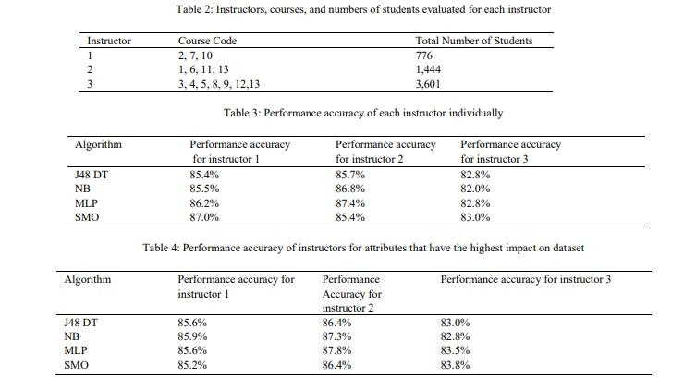
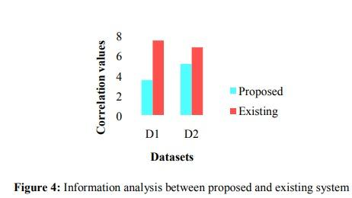
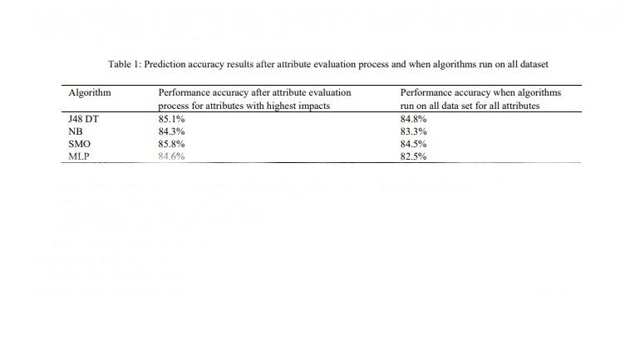

Slide 9
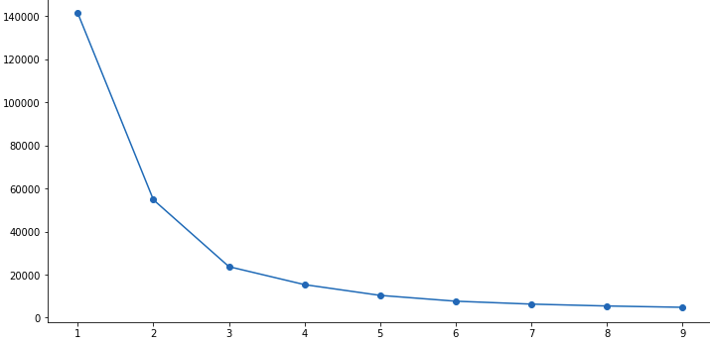
Results
Elbow method to decide number of clusters
Fom here we can decide number of clusters as = 3

Slide 10
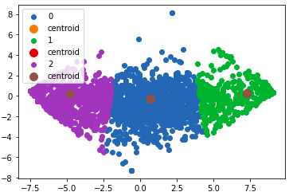
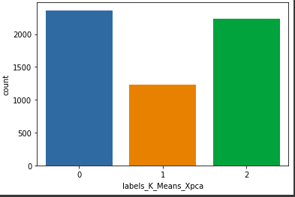
K-Means
SILHOUETTE SCORE :- 0.574080378086985
SUM SQUARED ERROR(SSE) :- 23705.171173
Cluster Values
0 :- 2362
1 :- 1229
2 :- 2229

Slide 11
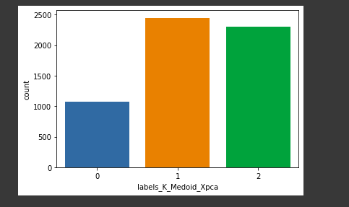
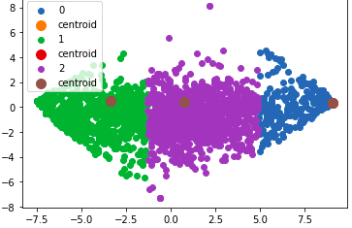
K-Medoid(PAM)
SILHOUETTE SCORE :- 0.563678558530737
SUM SQUARED ERROR(SSE) :- 9395.50047636649
Cluster Values
0 :- 1077
1 :- 2446
2 :- 2297

Slide 12
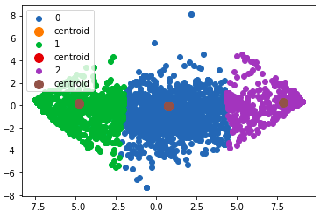
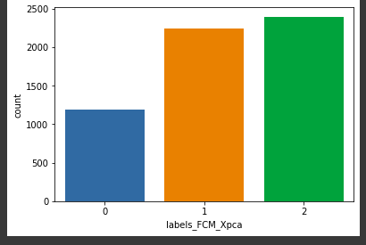
Fuzzy C-Means (FCM)
SILHOUETTE SCORE :- 0.573441776316902
SUM SQUARED ERROR(SSE) :- 24177.8712760322
Cluster Values
0 :- 1185
1 :- 2241
2 :- 2394

Slide 13
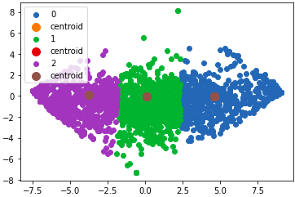
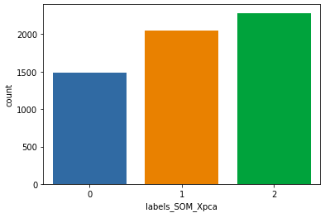
SOM(Self Organising Feature Map)
SILHOUETTE SCORE :- 0.545498165524238
SUM SQUARED ERROR(SSE) :- 33980.9664586133
Cluster Values
0 :- 1488
1 :- 2049
2 :- 2283

Slide 14
Analysis
Initially i have reduced the whole 28 dimension to 2 dimension,It co-relates the features that are similar and clubs them into 2d plot by maintaining the quality.
After applying all clustering Algorithms discussed in the class we can analyse the performance of each algorithm based on Sum squared Error(SSE) and Silhouette Score.
First I have decided number of clusters Using Elbow Method which came out to be = 3
By Comparing Silhouette Score of all algorithms K-Means(0.574080378086985) gave the Best Performance.
BY Comparing Sum squared Error(SSE) of all algorithms K-Medoid(9395.50047636649) gave the best performance
when it comes to convergence based on time, SOM(Self Organising Maps) gave the Best performance
From the Overall analysis we can tell that K-Means gave the best Performance for the given DataSet

